Slide 1

Visvesvaraya Technological University Belagavi
Project First Phase Seminar on
“Real-time and secure Wireless Health Monitoring System”
by
Under the guidance of
Dr. Manjunatha P
Professor
Department of Electronics and Communication Engineering
JNN College of Engineering, Shimoga- 577204
2021-2022
Amith N : 4JN18EC009
Arjun Kamath : 4JN18EC014
Chethan R : 4JN18EC021
Chinmay G P : 4JN18EC023
Batch 03

Slide 2
Presentation Flow
Introduction
Literature survey
Aim of the Project
Objectives
Methodology
Expected Results
Conclusion
Action Plan
References

Slide 3
Introduction
In this modern generation occurrence of diseases became more compared to earlier so it became necessary to take care of health.
Now a days heart attack cases are increasing also other diseases.so, as to get the emergency disfunctions from a hospitalized patient body , real time health monitoring is needed.
Continuous monitoring of critical patients and their biological parameters are transmitted to doctor’s console, and doctor’s domain address in person using Internet of Things technology (IoT).
This project helps to know the health condition of patient using wearable sensors. In this project, few important parameters has been chosen Electrocardiogram (ECG), Pulse rate, Temperature and Body Position detection by using wearable sensors.

Slide 4
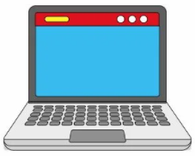
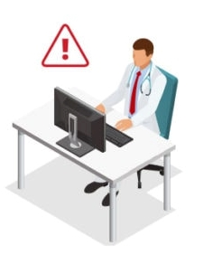
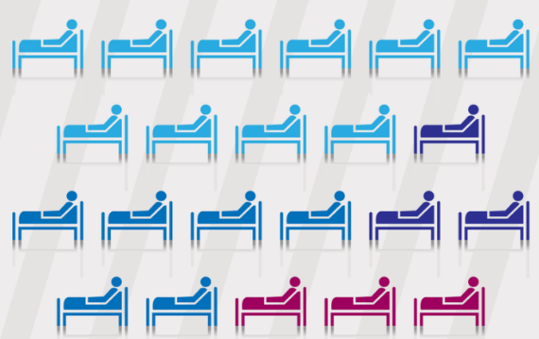
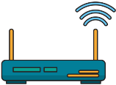
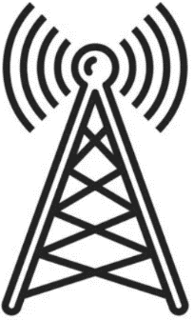
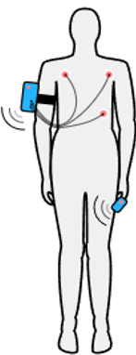

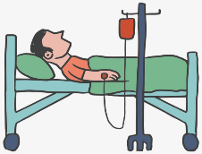
Root node
Server
Doctor
BLOCK 3
ECG sensor
Base station
Heart beat sensor
Root node
Root node
Temperature
sensor
Body position sensor
BLOCK 2
BLOCK 1
Fig(1):Conceptual architecture of Real-time health monitoring system

Slide 5
Literature survey
1.Secured Smart Healthcare Monitoring System Based on Iot
Authors: Mara Viqueira Villarejo ,Begoa Garca Zapirainetal
Dates: 2016,Alterations and Stress Using an ECG and a SCR
Technology plays the major role in healthcare not only for sensory devices but also in announcement, recording and display device.
Internet of things serves as a compound for the healthcare and plays prominent role in wide range of healthcare applications. In this project the PIC18F46K22 micro-controller is used as a gateway to communicate to the various sensors such as ECG sensor and pulse oximeter sensor.
Advantages:
Portable and user-friendly.
Disadvantage:
Inaccurate of data due to wrong positioning of devices.

Slide 6
2.welbeing monitoring through wireless sensor network and cloud computing using iot
Authors: Sunil L. Rahane, Prof. Ramesh S.Pawase, A Healthcare Monitoring System Using Wireless Sensor Network,.
Dates: 7, July 2017 , International Journal of Advanced Research in Electrical, Electronics and Instrumentation
In most of the hospitals health professionals use heart rate monitoring systems using manual methods to measure ECG by connecting lids to the chest of patient. The graph of ECG is monitored on the bedside monitor or special monitoring devices.
These devices are wired and bulky and do not support long distance communication. The systems have many disadvantages like requirement of costly hospital stays which is not affordable for longer periods, needs expert monitoring and high cost maintenance..
Many authors have reviewed the state of art systems available for monitoring different vital body parameters like temperature, ECG, heart rate & pulse rate.
Limitations : Not easy to deploy wireless sensor network nodes compared to wired networks.

Slide 7
3.Wearable Monitoring devices:
Authors: Teng XF, Zhang YT, Poon CC, Bonato P
Dates: IEEE Rev Biomed Eng. 2017
ECGs:
Electrocardiograms (ECGs) are among the most widely used biosignals, as a diagnostic tool in healthcare environment, providing information of the cardiac electrical cycle.
Heart rate:
Heart rate (HR) is a standard vital sign and has become a routine measurement in both healthcare and fitness/sport activities.
It is also a human psychophysiological status indicator, such as in stress and fatigue measurements
Advantages : Widely recognized technologies to be used for easy access.
Disadvantage : Adoption of new technologies is difficult to equip with for elders.

Slide 8
4.Continuous Heart rate Monitoring System using IoT:
Authors: Johan Bhurny Bathilde, Rajith Chameera, Dyg Norkhairunnisa Abang Zaidel.
Dates:2018
The author’s proposed an practical research to create a less expensive PPG sensor and this is achieved by using a combination of LED-photodiode to emit light and receive reflected light.
It penetrates into the tissues deep enough to detect a variety of blood volume.
A light-based sensor can be used to detect this variety of heartbeats, this is done using a non-invasive Photoplethysmography (PPG) sensor.
Advantages : Monitoring through single platform of hardware and software.
Limitations : Multiple applications lead to complexity.

Slide 9
5.Smart-phone Based Health Monitoring System:
Authors: Md. Milon Islam, Md. Rashedul Islam
Dates: 2019
The author’s proposed an effective approach, Smart phones are one of the most useful devices in the world.
A smart phone usually contains many types of sensors and many sensors to be added in the future.
Other sensors included in the smart-phone are wireless sensors, Bluetooth module, Accelerometer, Fingerprint sensor, Gyroscope, Magnetometer, Barometer, Proximity, GPS tracker, Camera, NFC - next to the field sensor most commonly used for health programs monitoring.
Advantages : Wifi-fingerprints are used to find the locations of patients in indoor environment during emergency situations.
Disadvantages : Data may not be accurate always due to environment interface by signals.

Slide 10
Aim of the Project
To design and develop IoT based Real-time and secured wireless patient health monitoring system using server to store the patient’s health data and alert the doctors in case of emergency.

Slide 11
Objectives
To detect Heart rate (ECG), pulse rate, body temperature and body position of a individual using wearable sensors.
To transmit these information successfully to the server.
To ensure data readability of the sensors where anybody can easily identify the status of the health without any prior technical knowledge.
To provide a fast responding alert mechanism and timely medical help for critically ill patients.

Slide 12
fig(1) Block diagram of smart health monitoring system
Note : N number of MCs are connected from
each patient to the Base station.
Real-time data from sensors and data storage
ECG sensors
(AD8232)
Body Movement sensors
(ADXL335)
Server
Doctor examining
NodeMCU
Base Station
Pulse Rate Sensors
Wired connection
Temperature sensors
(LM35)
Wireless connection

Slide 13
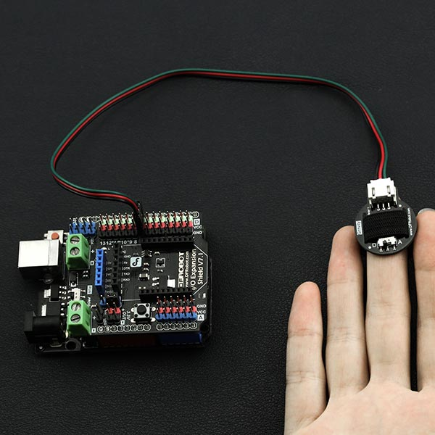
Methodology
STEP 1:
The Pulse Rate sensor is fixed to the patient’s finger. This contains an IR sensor in it. Every pumping we get pulse from that sensor. This sensor output is given to the ESP8266 NodeMCU via Signal conditioning unit for amplification.
Fig(2.2) Pulse Rate sensor on patient body

Slide 14
STEP 2:
NTC type thermistor is used as a temperature sensor. This temperature sensor output varies based on the temperature, this output is also given to NodeMCU.
fig(3) temperature sensor on patient body

Slide 15
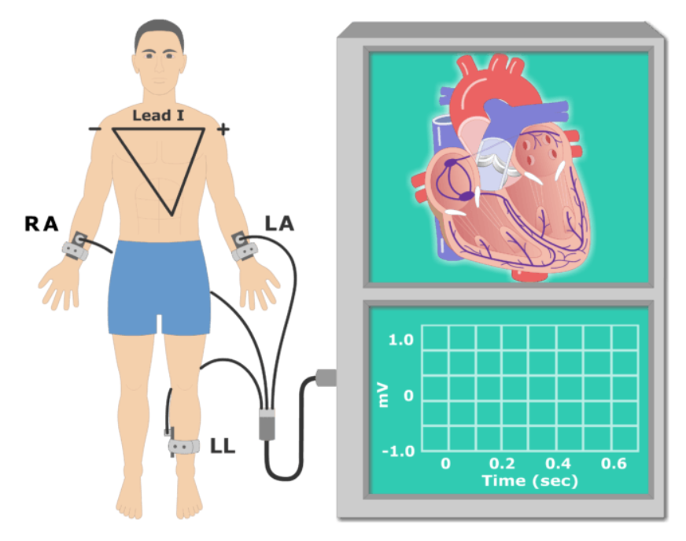
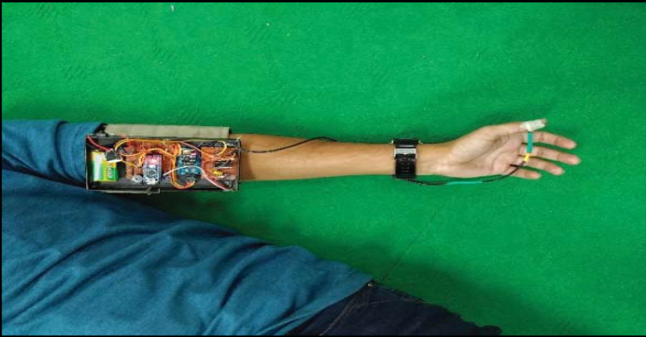
STEP 3:
ECG sensor is a cost-effective board used to measure the electrical activity of the heart. This electrical activity can be charted as an ECG or Electrocardiogram output as an analog reading. ECGs can be extremely noisy, the AD8232 Single Lead Heart Rate Monitor acts as an op-amp to help obtain a clear signal from the PR and QT Intervals easily and connected to NodeMCU.
Fig(3) ECG setup for a patient Sensors setup on patient

Slide 16
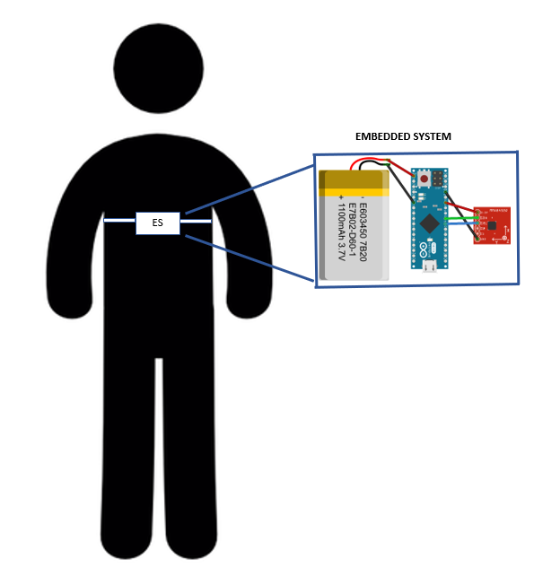
STEP4:
The accelerometer sensor ADXL335 used here is a full -3-axis accelerometer with small, thin, low power, signal outputs. This measures the full range of acceleration (± 3g). This sensor is able to find the gravitational fixed acceleration in various applications. The user sensor uses the X, Y and Z capacitors.
Accelerometer sensor
on patient body

Slide 17
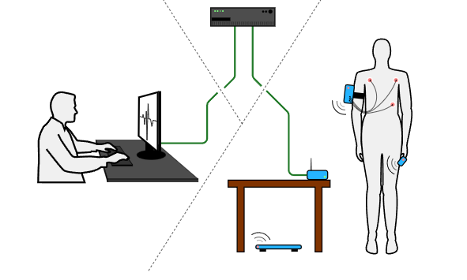
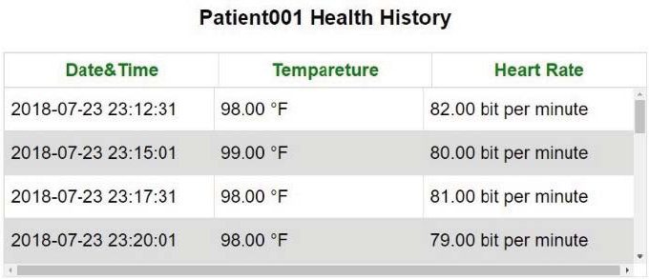
STEP 5:
All signals are collected in NodeMCU and transferred to the server where all data are stored. If the condition of the Patient is critical, it will alert the doctors through message alert.These sensors are connected NodeMCU it acts as a client and sends data on a specific server.
Here the base station gets all the signals from various sensors from more than one patient in a hospital blocks.
The parameters are continuously monitored by the doctor or a medical examiner.
Server
Patient
Doctor
Fig() overall scenario of smart health monitoring system

Slide 18
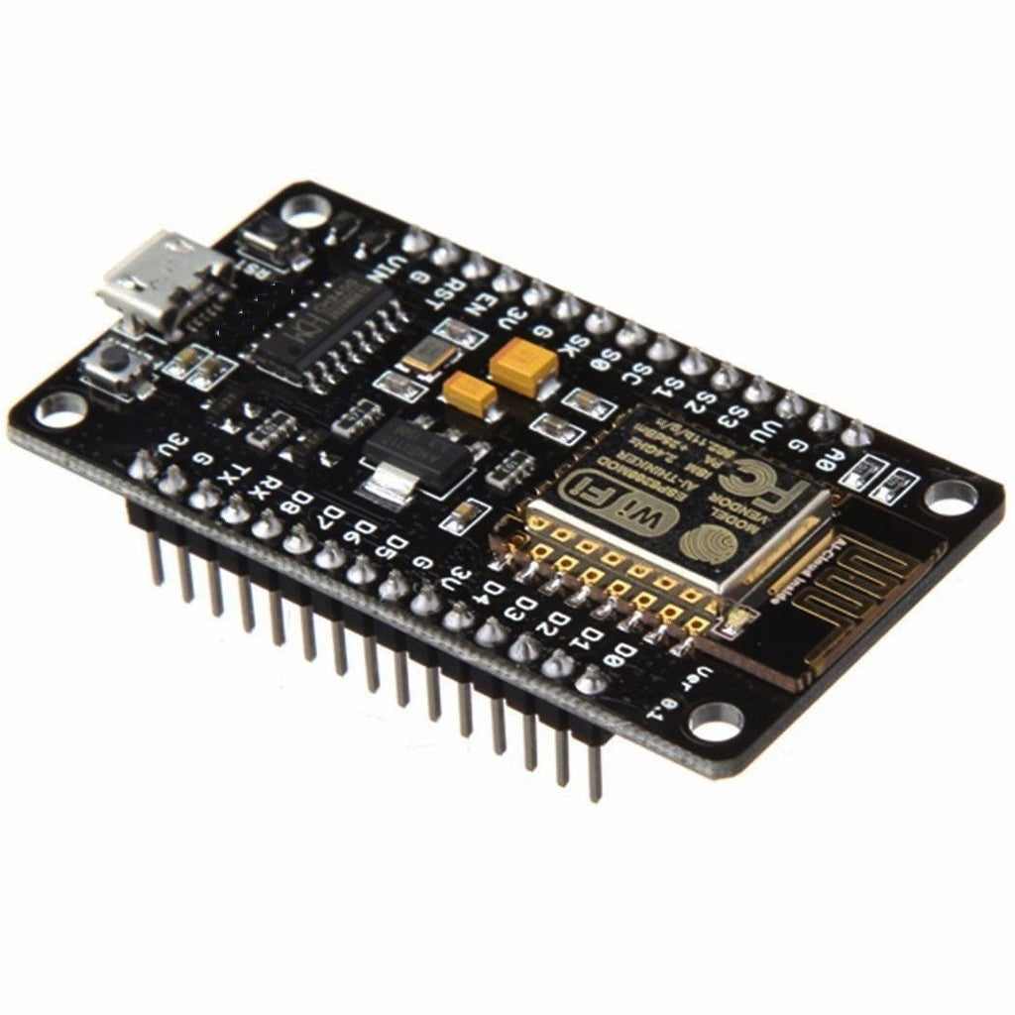
Hardware Specification
NodeMCU.
Main microcontroller Board with Wi-fi
And analog to digital converter.
Fig() Node Micro Controller Unit

Slide 19
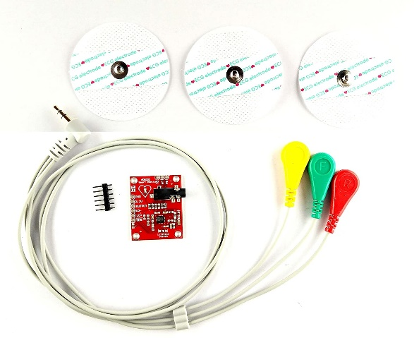
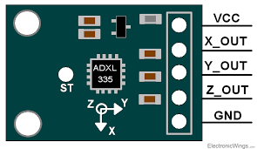
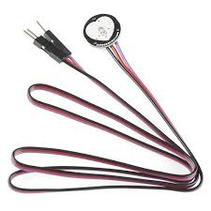
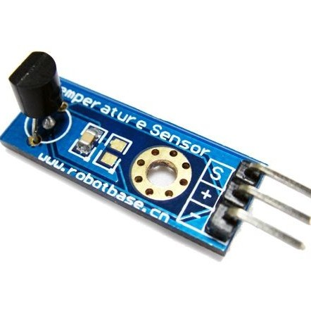
AD8232 ECG sensor
Pulse Rate sensor
ADXL335 Triple axis body movement sensor
LM35 Temperature sensor

Slide 20
Expected Results
The body parameters of a person sensed by the sensors are sent to the server with the help of Wi-Fi shield and the sensor details are displayed on the doctor’s screen.
Remote health monitoring system based on IoT, portable, energy efficient has given satisfactory results.
The system makes the use of sensors along with NodeMCU which is cost effective MC board.
The proposed system is very useful and valuable to the society especially like covid situations.

Slide 21
Conclusion
Our designed system provides low power consumption, simple architecture and cost-effective. Using this system, the problem of insufficient doctors can be solved.
The emergency alert system minimizes patient’s health risks. The database gives doctors the opportunity to make decision observing previous medical data.
This system is going to help minimize time wastage in a critical health situation. The system is accessible from Wi-fi by means of the internet. But still, there is some future development in our system to use the idea more fluently.
Our heart rate sensor need to be update as it is still unstable when patients are moving. For example, Blood pressure, ECG, etc. can be implemented in the system. More sensors mean more data for doctors to identify diseases. For data security, advanced database security can be implemented.
For a rural area, a video conference system can be included in the system which will give some extra benefit to prescribing medicine without traveling to a distance.

Slide 22
Action Plan:
Sl. No. | Tasks to be performed | Deadline ( Expected date/week of completion)
1. | Literature Survey | 13/12/2021 Completed
2. | Synopsis Submission | 20/12/2021 Completed
3. | Submission of First Phase Report | 30/01/2022 In Progress
4. | Objective 1 | 20/02/2022 To be done
5. | Objective 2 | 10/03/2022 To be done
6. | Objective 3 | 30/03/2022 To be done
7. | Objective 4 | 20/04/2022 To be done
8. | Testing & Result Analysis | 01/05/2022 To be done
9. | Documentation of Project Report | 15/06/2022 To be done

Slide 23
References
S. M. Riazul Islam, K. Daehan, M. Humaun Kabir, M. Hossain, and K. Kyung-Sup, "The Internet of Things for Health Care: A Comprehensive Survey," IEEE Access, vol. 3, pp. 678-708, 2015.
S. Kale, S. Mane and P. Patil, "IOT based wearable biomedical monitoring system," 2017 International Conference on Trends in Electronics and Informatics (ICEI), Tirunelveli, pp. 971-976, 2017.
P. Vogel, T. Klooster, V. Andrikopoulos and M. Lungu, "A Low-Effort Analytics Platform for Visualizing Evolving Flask-Based Python Web Services," 2017 IEEE Working Conference on Software Visualization (VISSOFT), Shanghai, pp. 109-113, 2017.
“Raspberry Pi 3 Model B,” Raspberry Pi. [Online]. Available: https://www.raspberrypi.org/products/raspberry-pi-3-model-bplus/.[Accessed: 06-Jul-2018].
Ti.com. (2018). LM35 ±0.5°C Temperature Sensor with Analog Output and 30V Capability | TI.com. [Online] Available at: http://www.ti.com/product/LM35 [Accessed 10 Jul. 2018].
SIM Technology Group Ltd. (2018). SIM900/SIM900A GSM/GPRS Minimum System Module - ITEAD Wiki. [Online] Itead.cc. Available at: https://www.itead.cc/wiki/SIM900/SIM900A_GSM/GPRS_Minimum_System_Module [Accessed 10 Jul. 2018].

Slide 24
Multicomp (2018). Piezoelectric sensor. [Online]En.wikipedia.org. Available at:https://en.wikipedia.org/wiki/Piezoelectric_sensor [Accessed 10 Jul. 2018].
Jusak Jusak, Heri Pratikno, Vergie Hadiana Putra. “Internet of Medical Things for Cardiac Monitoring: Paving the Way to 5G Mobile Networks”, 2016 IEEE International Conference on Communication, Networks and Satellite (COMNETSAT), 2016 .
Tanveer Reza, Sarah Binta Alam Shoilee, Sirajum Munira Akhand, Mohammad Monirujjanan Khan. “Development of Android Based Pulse Monitoring System”,IEEE , 2017

Slide 25
Thank you Questions?

